Slide 1

Harborne Primary School
SEND Improvement Strategy 2025–2026
“Every child deserves a quality education and the support to thrive.”

Slide 2

Acknowledging the Ofsted Feedback
What Ofsted Told Us (May 2025):
Pupils with SEND do not receive the standard of education they deserve
Systems for identification, assessment, and support are not effective
Staff training and external support require urgent attention
Pupils with SEND are disproportionately affected by suspensions
🔍 We take these findings extremely seriously and are committed to change.

Slide 3
Immediate Leadership Action
Our Response Since the Inspection:
Commissioned Mrs Herera (May 2025) to build robust systems
Prioritised statutory compliance and early intervention
Conducted internal reviews and reallocated key roles
Reaffirmed SEND as a school-wide priority

Slide 4
Strengthening Capacity
Challenges Identified:
Recruitment of trained key workers for complex needs
Inconsistent monitoring (INSIGHT vs paper-based systems)
Our Action Plan:
Recruiting SEND Key Workers for Autumn Term
Unifying systems to improve progress tracking
Investing in skilled staff to work 1:1 with high-need pupils

Slide 5
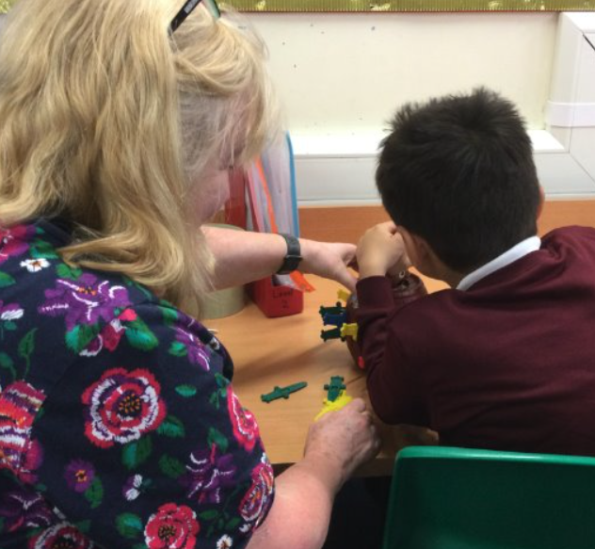
Improving Behaviour Support
Context:
SEND pupils accounted for the majority of suspensions this year
Our Support Strategy:
Commissioned external experts: COBs, PSS, Ed Psych, CAT, STICK
Strengthened individual support plans
Increased purchased hours for 2025–2026
TA placements in other schools to observe best practice
Commitment to whole-school behaviour training in Autumn

Slide 6
Staff Training & Expertise
Training in Progress:
Refresher sessions on the SEND Toolkit
Focused CPD on adaptive practice, inclusion, and behaviour support
Bespoke training on effective deployment of Teaching Assistants
🛠️ We are ensuring that every adult is equipped to support every child.

Slide 7
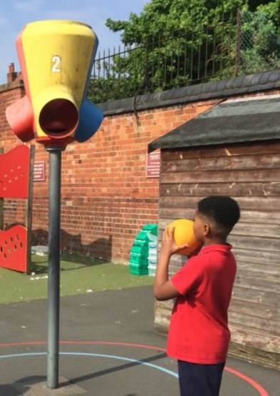
Embedding Effective Systems
From September 2025:
One digital system for SEND identification, assessment & planning
Consistent use of impact measures across all year groups
Increased use of 'Five-a-Day' strategies for targeted support
Termly reviews for every child on the SEND register

Slide 8
Partnership and External Expertise
Proactive use of multi-agency professionals
Timely referrals and shared support planning
Additional hours commissioned to reduce waiting times and delays
Inclusion of families in decision-making from the outset

Slide 9
Our Vision for SEND at Harborne
By July 2026, we aim to ensure:
Every child’s needs are accurately identified early
Quality teaching is consistently adapted for all learners
Staff feel confident and supported to meet diverse needs
Parents and carers feel listened to, informed, and included
Pupils with SEND make strong progress from their starting points

Slide 10
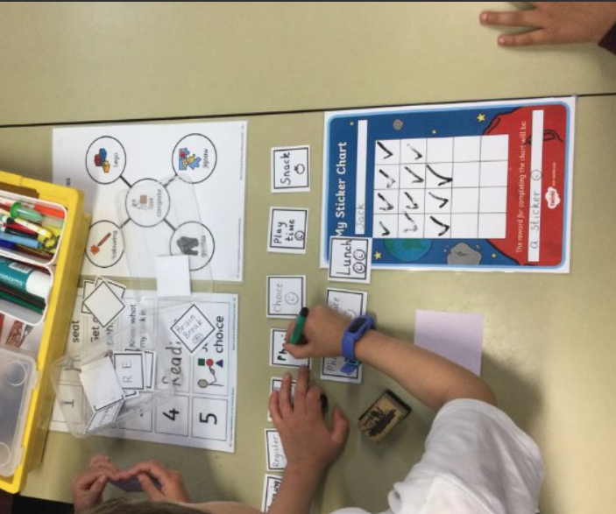
How Parents and Carers Can Support from Home
Working Together to Support Every Child
What You Can Do at Home:
Maintain regular communication with your child’s class teacher and Mrs Phillips (SENDCo)
Share insights about your child’s strengths, triggers, and what works well at home
Support routines that promote independence (e.g. visual timetables, checklists)
Encourage your child’s voice in planning and reflection
Celebrate small steps of progress—academic, social, or emotional

Slide 11
Realistic Expectations
Progress may look different for every child—especially those with complex needs
Some strategies take time to embed and show impact
We are working to build capacity and consistency across the school

Slide 12
Local Context – Birmingham SEND Provision:
Birmingham’s SEND services are undergoing significant reform following the Ofsted/CQC Area SEND Inspection (June 2025)
The inspection acknowledged systemic weaknesses but also recognised the Local Area Partnership’s commitment to improvement
A city-wide SEND and AP Improvement Plan is now in place, focusing on early identification, transitions, and locality working

Slide 13
Our Commitment:
We will continue to advocate for timely support and clear pathways
We will keep you informed about changes and opportunities to engage
We value your partnership in shaping a more inclusive and responsive school

Slide 14
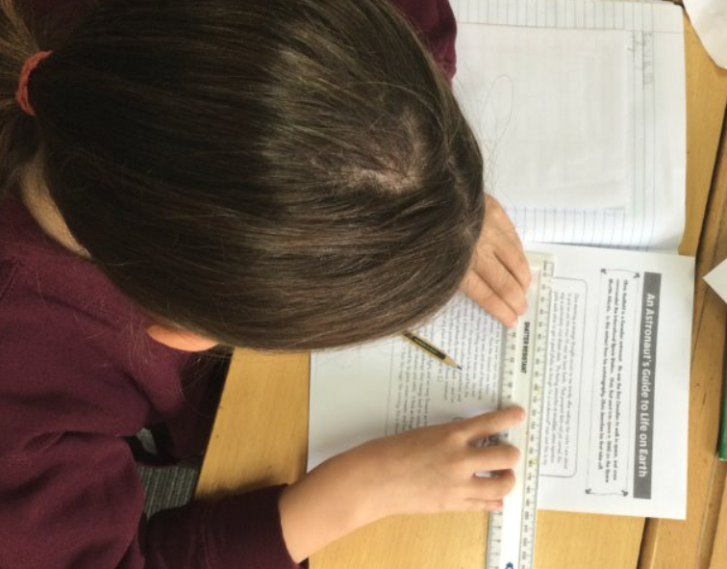
Thank You and Next Steps
We understand the frustration and uncertainty of recent months.
Thank you for your patience, advocacy, and support. We are committed to partnership, transparency, and improvement.
If you have questions or would like to be involved, please speak with your class teacher or arrange to meet with Mrs Phillips (SENDCo).

