Slide 1
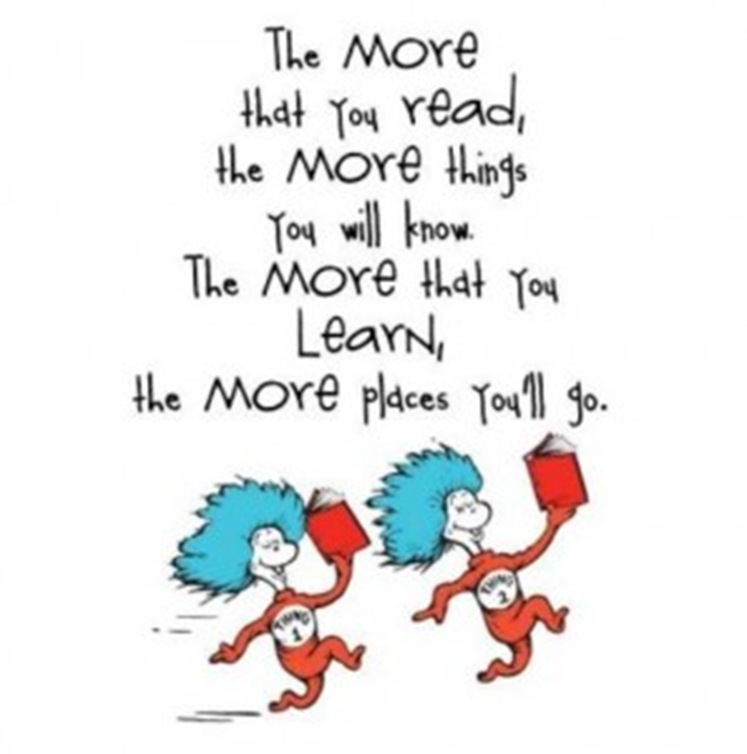


Reading at Harborne Primary School
September 2026

Slide 2
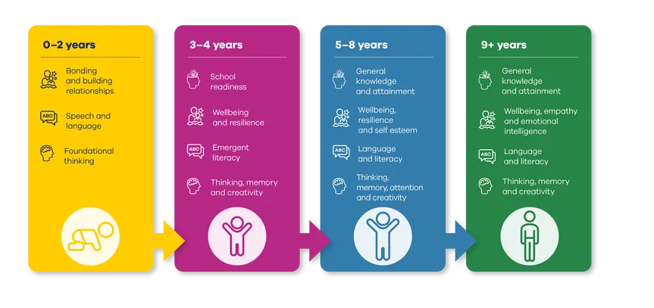
The benefits of reading – Booktrust.org.uk

Slide 3
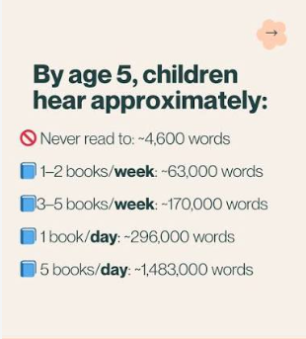
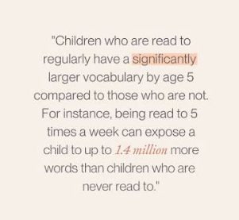

Slide 4
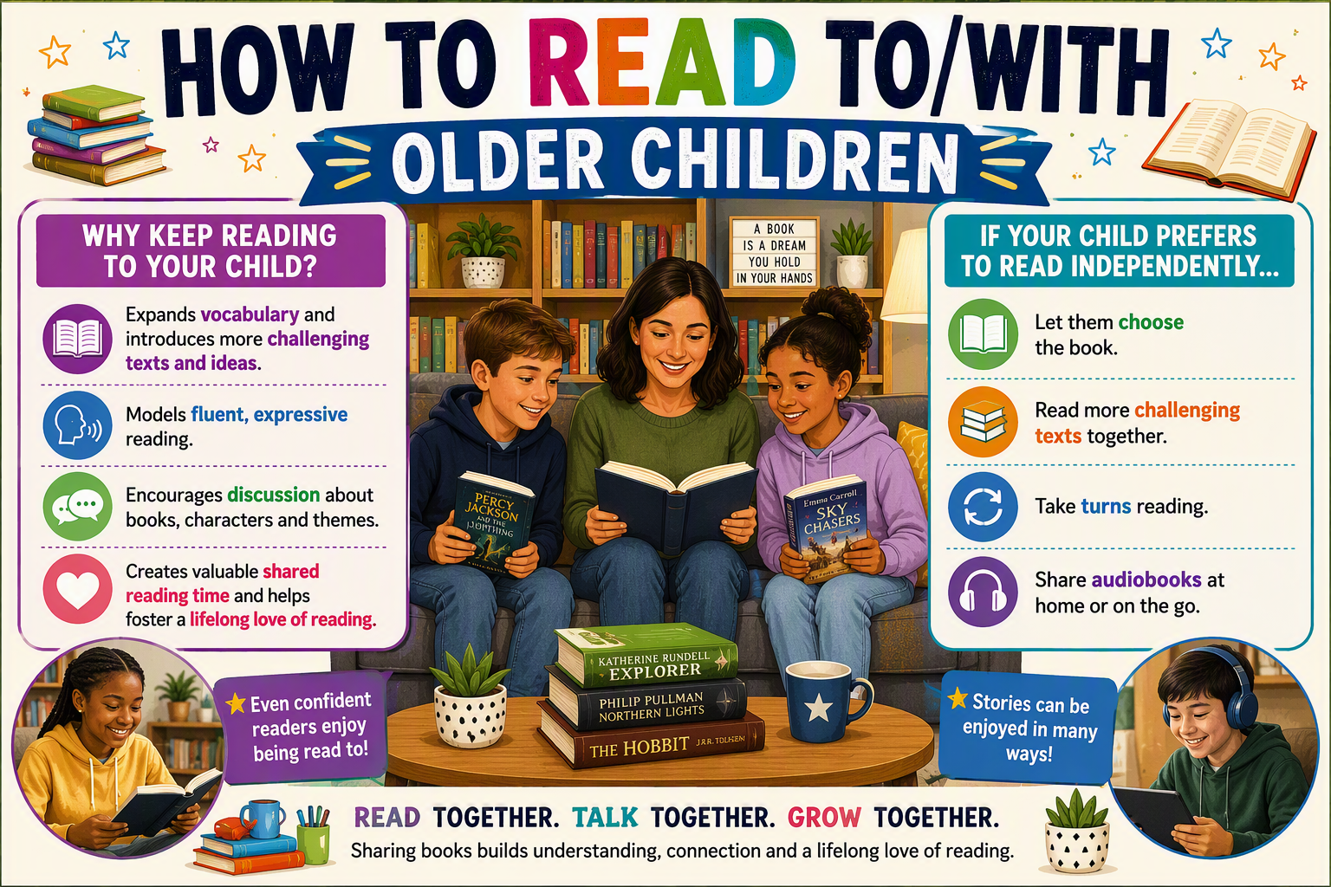

Slide 5
Reading at Harborne Primary School
At Harborne Primary school we use a fluency first approach to all of our reading.
EYFS/KS1 Phonics – Little Wandle phonics
KS2 Reading – Whole class Reading
Fluency Approach
A fluent reader is one who can accurately and automatically decode words.
“Reading fluency is the essential bridge that connects basic word decoding to deep text comprehension.” Tim Rasinski

Slide 6
Reading at
Harborne Primary School
We love reading and we want all of our pupils to love it too. We create a culture of reading for pleasure and children benefit from a variety of book-themed events and good links with our local library. As part of our programme of teaching in English, we use a range of quality literature across the school. We have a well-stocked library and classroom libraries in school. We use ‘sharing books’ to encourage children to share books and read widely at home and at school.

Slide 7
Three types of reading sessions
Extended Reading
Close Reading
Fluency Reading
Involves prolonged engagement with a longer extract or text and focuses on the development of word knowledge, background knowledge and text knowledge through exposure to text.
Involves sustained, detailed analysis of a short text or extract and focuses on the development of word knowledge, background knowledge and text knowledge through deep discussion.
The focus is on developing accuracy, automaticity and prosody. Using shorter extracts to model fluency and then allowing children to practice.
All whole class sessions

Slide 8
Extended read
The Lion, the Witch and the Wardrobe” by C.S. Lewis
(Chapter 1 – Lucy Looks into a Wardrobe)
  “Lucy felt a little frightened, but she felt very inquisitive and excited too. She looked back over her shoulder and there, between the dark fir trees, she could still see the open doorway of the wardrobe and even catch a glimpse of the empty room from which she had set out.”
Why it works as an extended read
Word knowledge: Words like inquisitive, fir trees, and wardrobe can be explored for meaning and imagery.
Background knowledge: Introduces fantasy settings and the idea of portals to other worlds — great for connecting to myths and imagination.
Text knowledge: Pupils can study how suspense and curiosity are built through description and pacing.

Slide 9
Close read
Lucy felt a little frightened, but she felt very inquisitive and excited too. She looked back over her shoulder and there, between the dark fir trees, she could still see the open doorway of the wardrobe and even catch a glimpse of the empty room from which she had set out.
Discussion focus:
Word Knowledge :
Discuss how inquisitive differs from curious — what kind of curiosity does it suggest?
Background Knowledge:
Discuss how the setting (dark fir trees, wardrobe doorway) creates a sense of mystery and adventure.
Text Knowledge:
Look at sentence structure: how commas and conjunctions slow the pace and mirror Lucy’s hesitation.

Slide 10
Fluency Read (1)
Lucy felt a little frightened, but she felt very inquisitive and excited too. She looked back over her shoulder and there, between the dark fir trees, she could still see the open doorway of the wardrobe and even catch a glimpse of the empty room from which she had set out.
Fluency Reading Focus
Accuracy – Model reading the passage slowly and clearly, ensuring every word is pronounced correctly.
Automaticity – Encourage pupils to reread the extract several times until they can read smoothly without hesitation.
Prosody – Demonstrate expressive reading: vary tone and pace to show Lucy’s mix of fear and excitement.

Slide 11
Fluency Read (2)
Lucy felt a little frightened, but she felt very inquisitive and excited too. She looked back over her shoulder and there, between the dark fir trees, she could still see the open doorway of the wardrobe and even catch a glimpse of the empty room from which she had set out.
Teacher modelling – Read the passage aloud with expression, showing how tone changes between frightened and excited.
Echo reading – Pupils repeat each sentence after the teacher, matching pace and intonation.
Paired practice – Children practise reading aloud to a partner, focusing on flow and natural speech.
Performance reading – Invite pupils to read the extract dramatically, as if narrating Lucy’s adventure

Slide 12
Little Wandle Letters and Sounds
Some children may still receive Rapid Catch Up in Year 4, 5 and 6.
Little Wandle Letters and Sounds Revised is the fastest-growing, Department for Education-validated phonics programme used by over 5,000 primary schools in the UK and internationally.
One recent survey revealed that over 96% believed that Little Wandle was having a significant impact on the consistency of practice across their school!
Children read diverse, engaging, fully decodable books that match the sounds they know
Ofsted have identified how the Little Wandle programme has supported schools to develop a love of reading, ensure decodable texts are well-matched to children’s developing phonics knowledge and to ensure that early reading is prioritised, amongst other things!

Slide 13
Beyond reading diaries
This year, we will not be using reading diaries to record reading.
Research suggests that:
Reading records can make reading feel like a task rather than an enjoyable activity.
Children may begin to associate reading with pressure or obligation.
This does not mean that home reading will stop.
We still expect children to read at home regularly, with the focus on fostering a lifelong love of reading.

Slide 14
What now?
Children should read daily at home to an adult.
All children will still receive their levelled book and a sharing book from the classroom library.
Children will share their reading and favourite books/ authors during Book Club in school on Fridays.
KS2 Children to complete a weekly quiz at home on Oxford Reading Buddy following completion of a book.

Slide 15
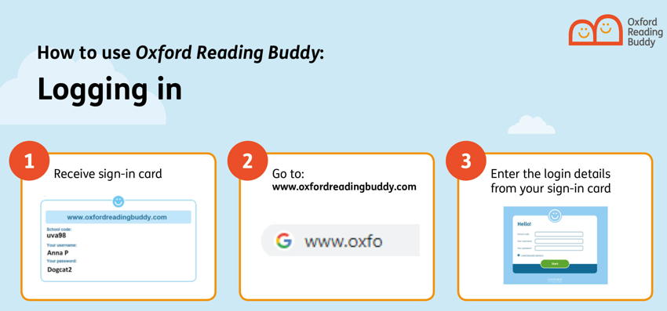
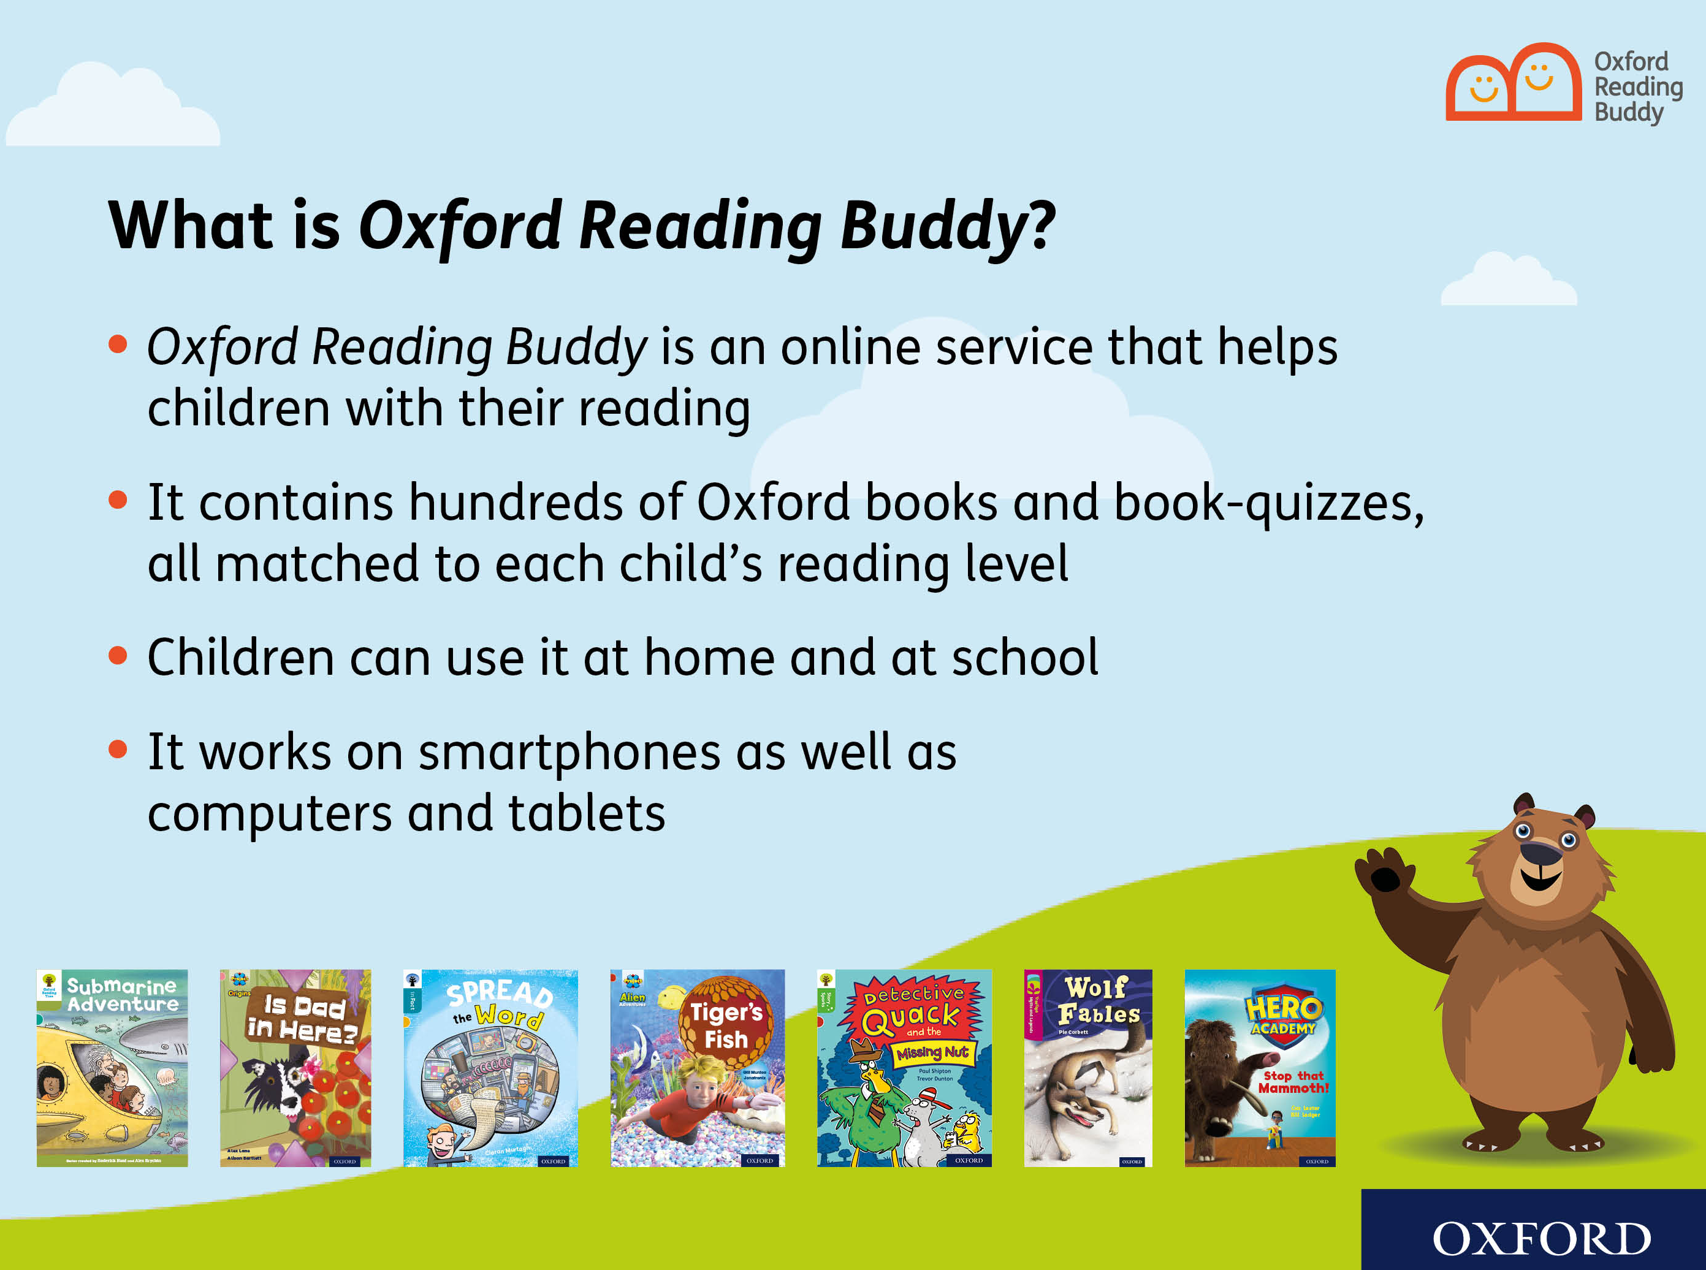
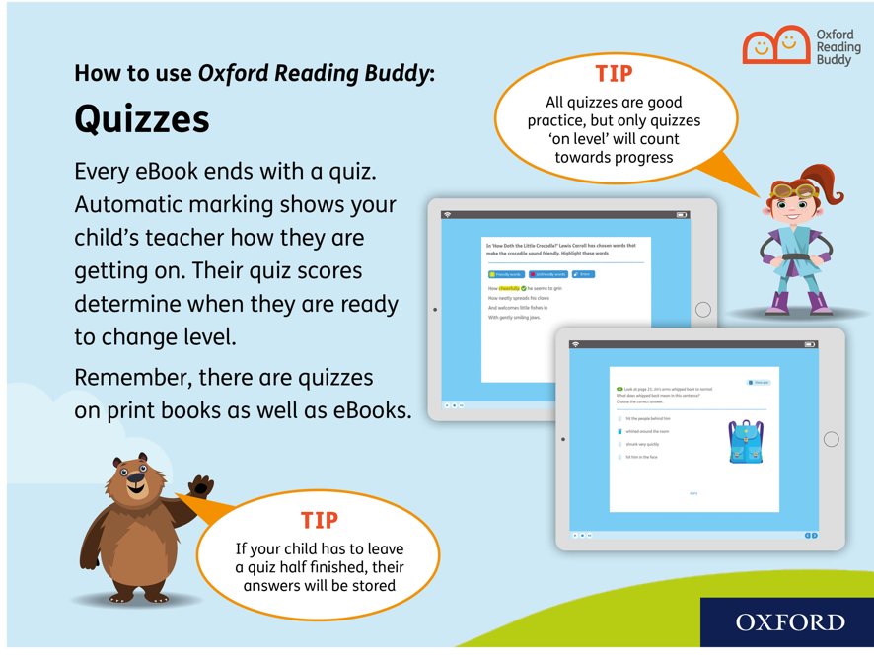
Oxford Reading Buddy
Our school online digital reading service

Slide 16
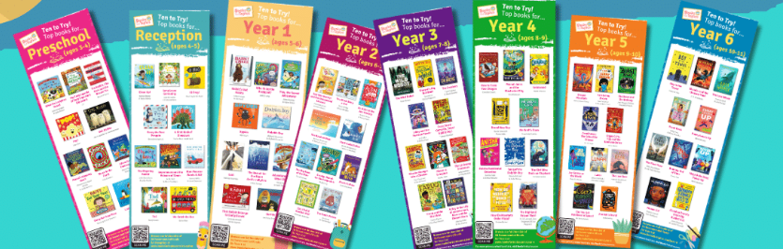
Reading challenges
This year the children will be able to take part in a series of reading challenges to achieve their Bronze, Silver and Gold Reading Awards.
Children will need to read 5 books per half term to an adult and get their record sheet signed by parents/carers.
The books will need to be a range of genres and represent our diverse community.
Ideas can be found on https://www.booksfortopics.com/

