Slide 1
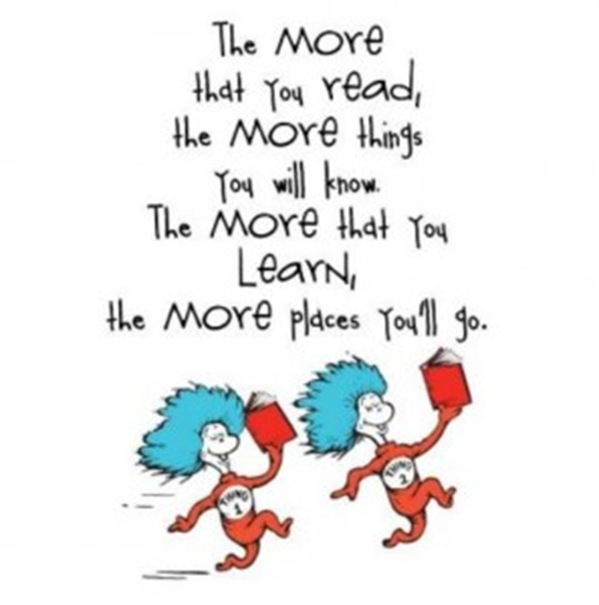


Early Reading at Harborne Primary School
September 2026

Slide 2
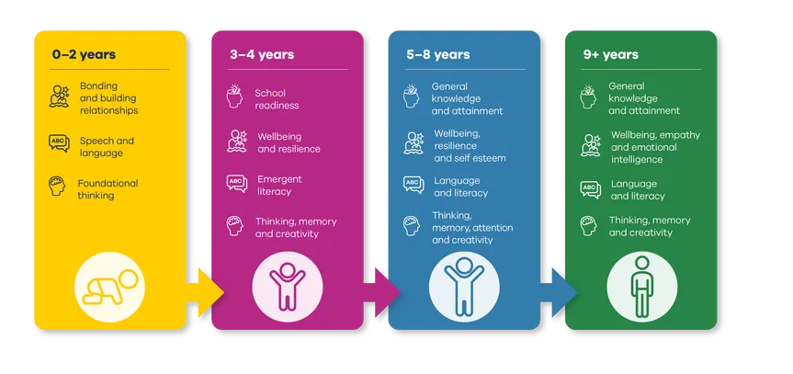
The benefits of reading – Booktrust.org.uk

Slide 3
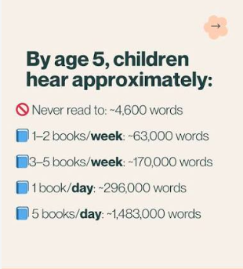
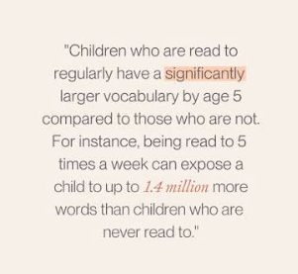

Slide 4
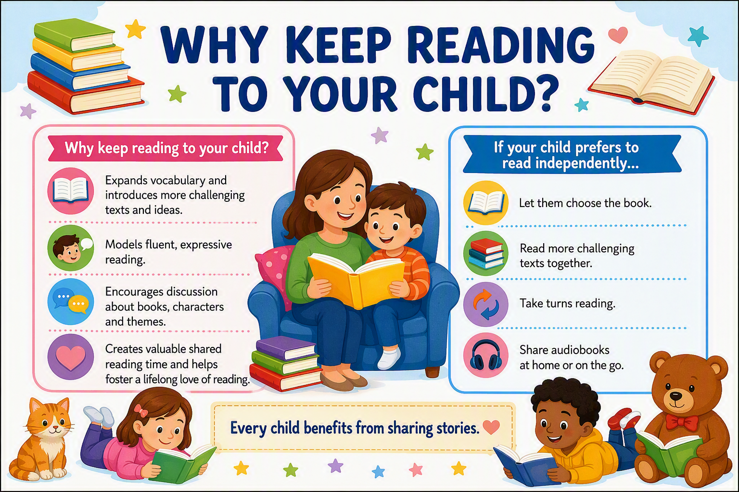

Slide 5
Reading at Harborne Primary School
At Harborne Primary school we use a fluency first approach to all of our reading.
EYFS/KS1 Phonics – Little Wandle Phonics
KS2 Reading – Whole class Reading
Fluency Approach
A fluent reader is one who can accurately and automatically decode words.
“Reading fluency is the essential bridge that connects basic word decoding to deep text comprehension.” Tim Rasinski

Slide 6
Reading at
Harborne Primary School
We love reading and we want all of our pupils to love it too. We create a culture of reading for pleasure and children benefit from a variety of book-themed events and good links with our local library. As part of our programme of teaching in English, we use a range of quality literature across the school. We have a well-stocked library and classroom libraries in school. We use ‘sharing books’ to encourage children to share books and read widely at home and at school.

Slide 7
What is fluency?
https://www.google.com/goto?url=CAESYwHrOzAVRjQso_09TaeoImR198Fty3hrlM-jYxl4hipN1Zkfni5h9Aax4rb8eWXqP5_VwvxOxMYXp3g7xN2xIw3hBQVQlk3VY7tqyMzo8PCJp0i7pNdxYYJx3AQSRB9LAGIE7Q

Slide 8
Little Wandle Letters and Sounds
Little Wandle Letters and Sounds Revised is the fastest-growing, Department for Education-validated phonics programme used by over 5,000 primary schools in the UK and internationally.
One recent survey revealed that over 96% believed that Little Wandle was having a significant impact on the consistency of practice across their school!
Children read diverse, engaging, fully decodable books that match the sounds they know
Ofsted have identified how the Little Wandle programme has supported schools to develop a love of reading, ensure decodable texts are well-matched to children’s developing phonics knowledge and to ensure that early reading is prioritised, amongst other things!

Slide 9
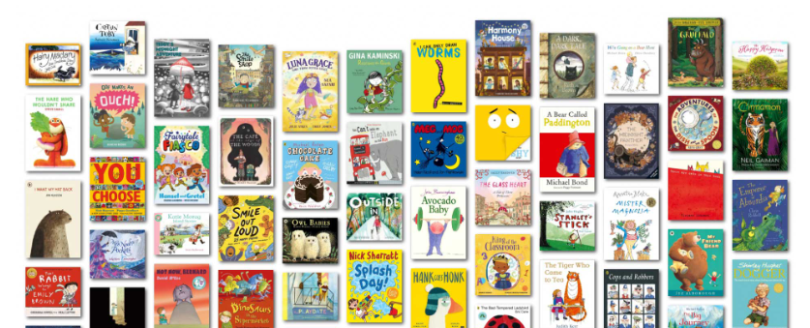
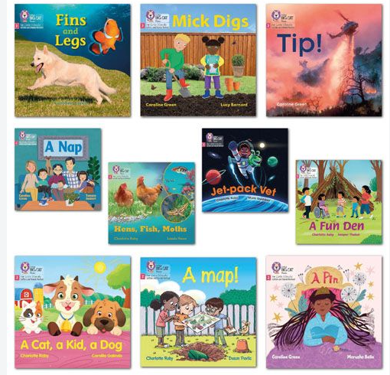
What will your child bring home?
Reading practice book Sharing book
https://www.littlewandle.org.uk/resources/for-parents/#tabnametabBooksComingHome

Slide 10
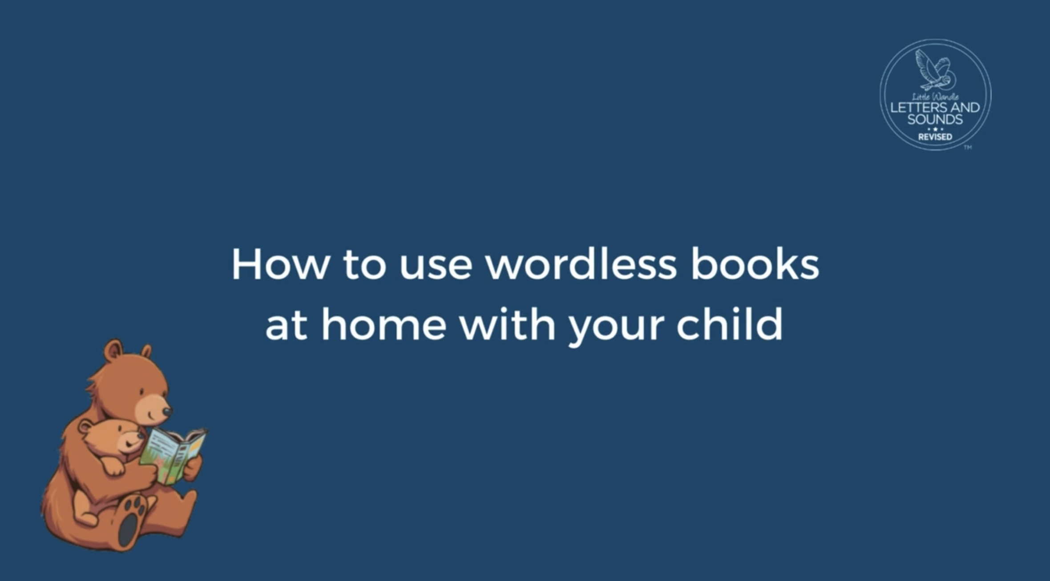
Wordless books
https://www.littlewandle.org.uk/resources/for-parents/#tabnametabBooksComingHome

Slide 11
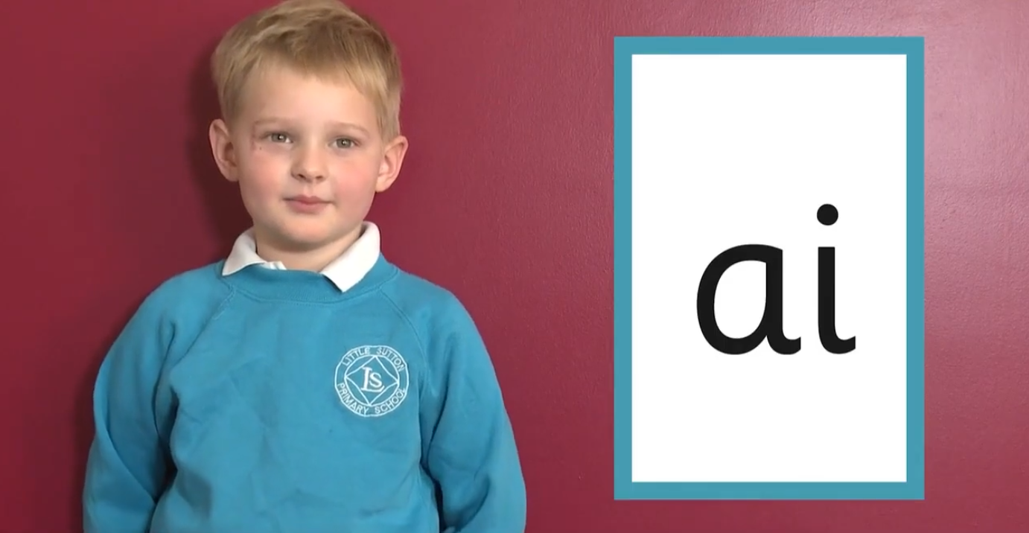
How to say the sounds
https://www.littlewandle.org.uk/resources/for-parents/#tabnametabSupportForPhonics

Slide 12

How we teach blending
https://www.littlewandle.org.uk/resources/for-parents/#tabnametabHowWeTeach

Slide 13
Beyond reading diaries
This year, we will not be using reading diaries to record reading.
Research suggests that:
Reading records can make reading feel like a task rather than an enjoyable activity.
Children may begin to associate reading with pressure or obligation.
This does not mean that home reading will stop.
We still expect children to read at home regularly, with the focus on fostering a lifelong love of reading.

Slide 14
What now?
Children should read daily at home to an adult.
All children will still receive their reading practice book (at their phonic level) and a sharing book from the classroom library.
EYFS and KS1 will read their levelled book at home to develop fluency and confidence. The aim is children will leave school at 90% fluency and return at over 95% fluency in the reading practice book.
In EYFS/KS1 Little Wandle assessments will happen every 6 weeks.

Slide 15
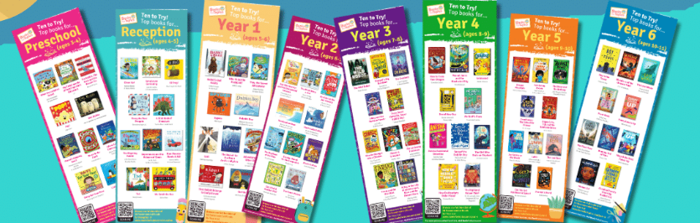
Reading challenges
This year the children will be able to take part in a series of reading challenges to achieve their Bronze, Silver and Gold Reading Awards.
Children will need to read 5 books per half term to an adult and get their record sheet signed by parents/carers.
The books will need to be a range of genres and represent our diverse community.
Ideas can be found on https://www.booksfortopics.com/

